Slide 1
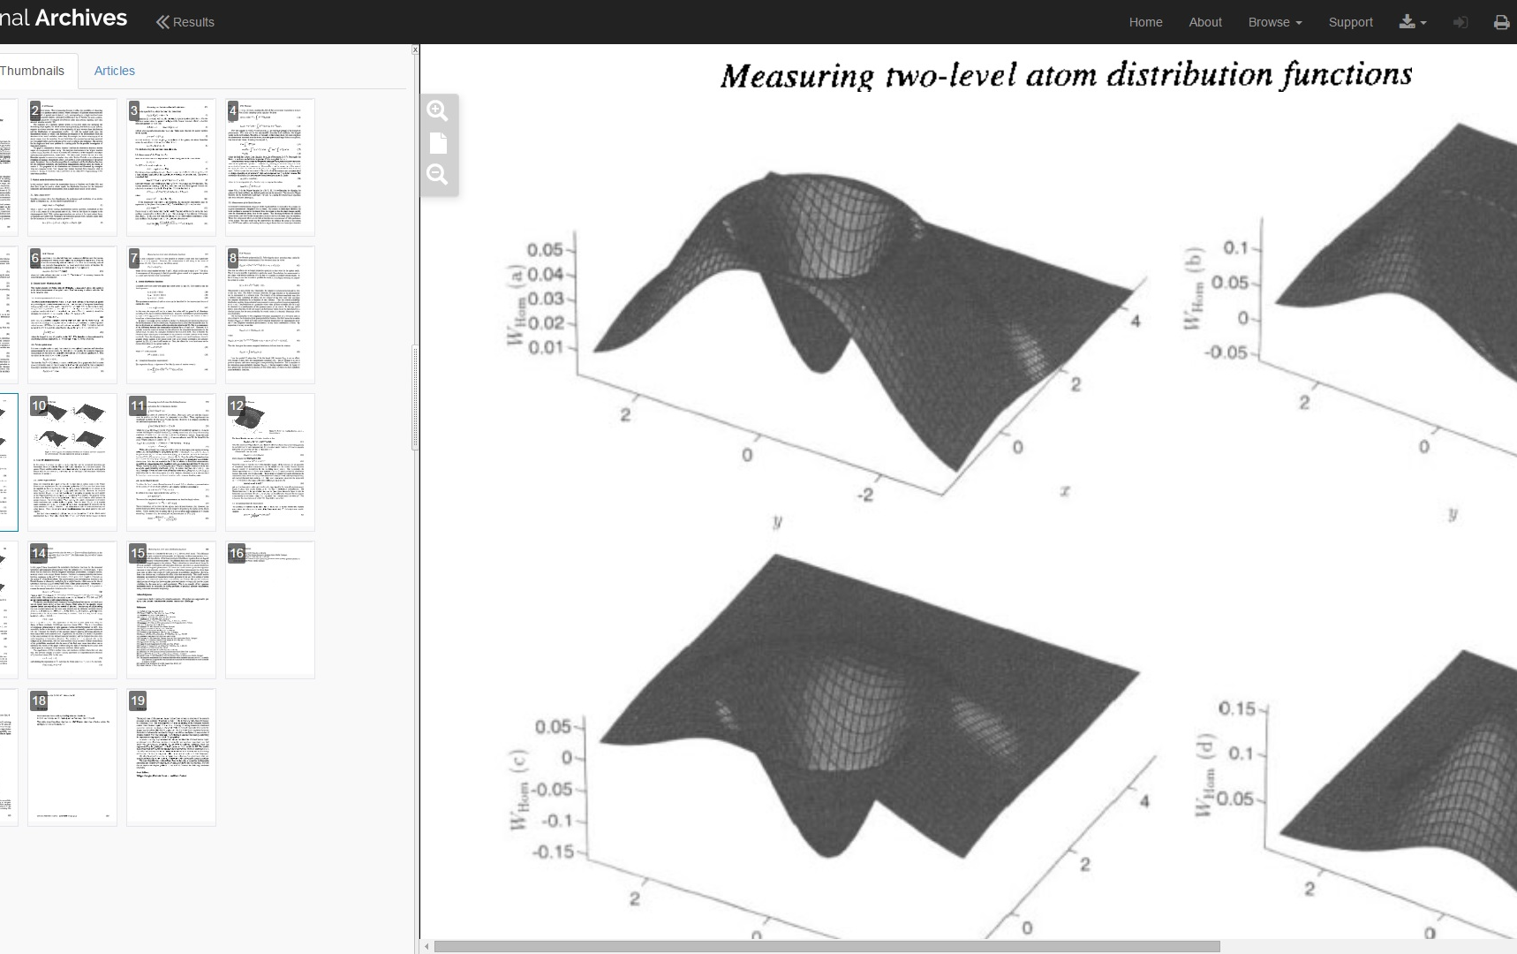
Introduction to Journal Archives
Over 4 million articles from over 600 journals, sourced from 8 major publishers 1827-2009

Slide 2
What is Journal Archives?
Journal Archives brings together over 600 journals from 8 major publishers, plus the complete run of the Feminist magazine “Spare Rib”, with material spanning the 19th and 20th centuries, encompassing a wealth of subject areas.
Brill Journal Archive Online - Part 1 (Vol 1 to 1999) and Part 2 (2000 -2009)
Cambridge Journals Digital Archive (1827 – 1996)
Institution of Civil Engineers Virtual Library Archive (1836-2001)
Institute of Physics (IOP) Journal Archive (1874-1998)
Periodicals Archive Online - Jisc Collections Selection (1891 – 2000)
Oxford Journals Archive and Archive Upgrade (Oxford University Press) (1849 - 1995)
Royal Society of Chemistry (RSC) Journals Archive (1841-2004)
Taylor & Francis Geography, Planning, Urban and Environment Online Archive (1885 to 1996)
Spare Rib journal archive (1972-1992)

Slide 3
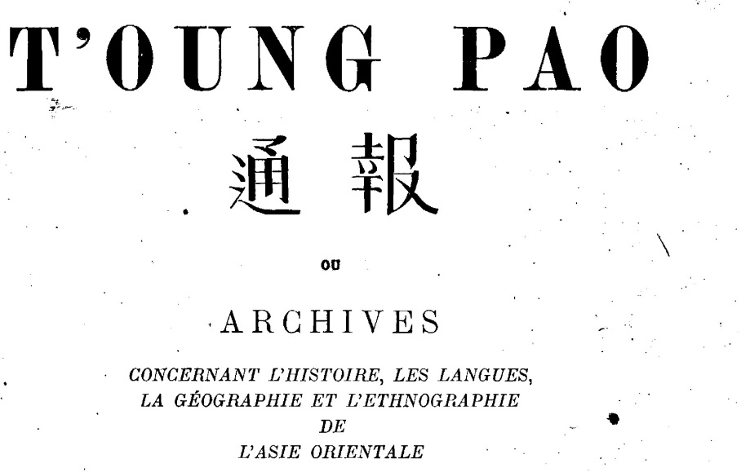
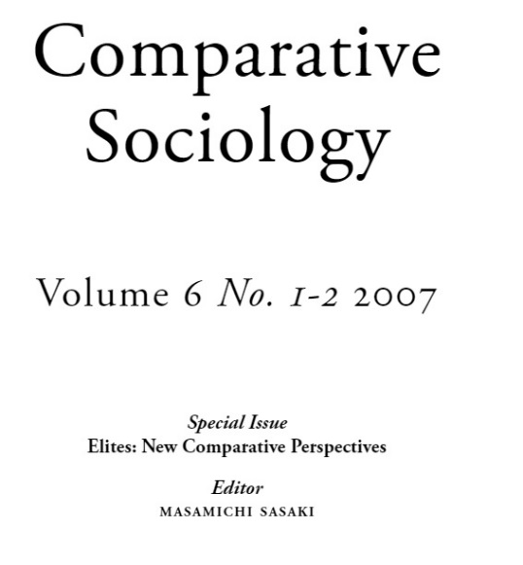
Brill Journal Archive Online
Part 1 (Vol 1 to 1999) and Part 2 (2000 -2009)
Over 50,000 articles from more than 80 journals published by Brill, Martinus Nijhoff and VSP prior to 2000.
Part 1 includes journals from the 19th and 20th century, usually starting from volume 1 issue 1 and going up to the last issue published in 1999. The collection covers a range of subject areas including humanities and social sciences, international law and human rights, as well as biology and science.
Part 2 provides the content of 154 journals published by Brill since 2000 from the subject areas of Humanities and Social Sciences, International Law and Human Rights, Science and Biology

Slide 4
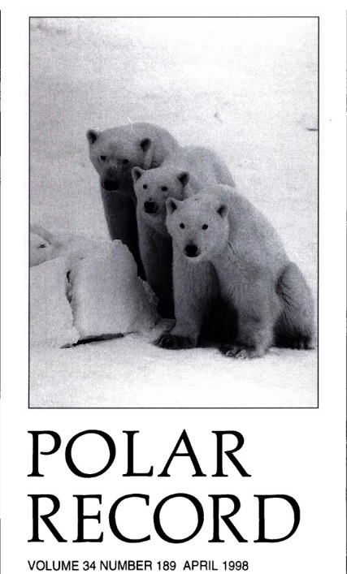


Cambridge Journals Digital Archive
(1827-1996)
Over 350,000 articles from more than 171 journals published by Cambridge University Press, comprising the back volumes of all available Cambridge titles to volume 1 issue 1, with coverage starting from 1827 up to approximately 1996. There are three specific subject collections:
Scientific, Technical and Medical
Humanities and Social Sciences, Part 1: Economics History Law Politics and International Relations
Humanities and Social Sciences, Part 2: Anthropology and Archaeology, Asian Studies, Classics, Music, Drama, Language and Linguistics, Philosophy, Religion

Slide 5
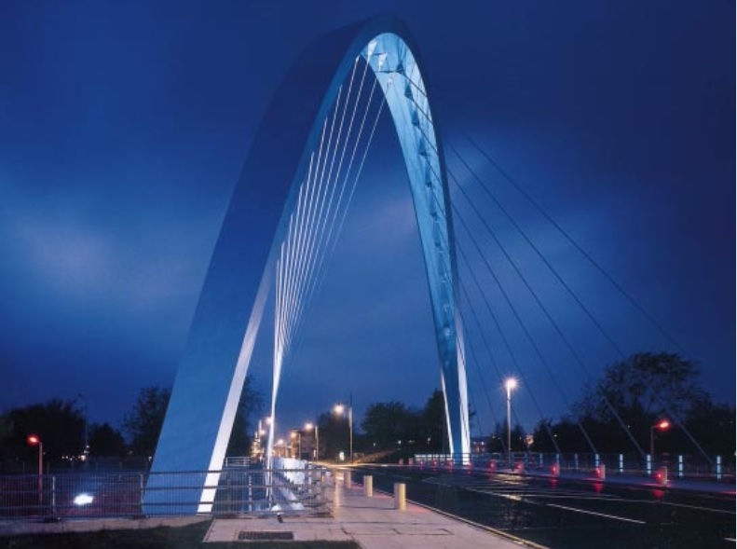
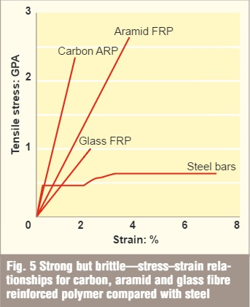
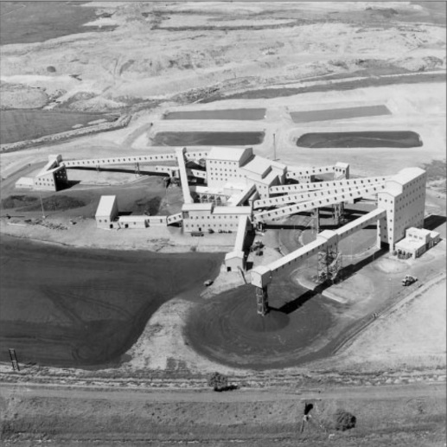
Institution of Civil Engineers Virtual Library Archive
(1836-2001)
Incorporating every paper published by the Institution of Civil Engineers between 1836 and 2001, comprising over 200,000 pages providing a comprehensive civil and structural engineering archive of internationally renowned titles.
Specific subject areas covered include architecture, the built environment, building studies, construction, environmental studies, land management, property management, planning, transportation and urban design.

Slide 6
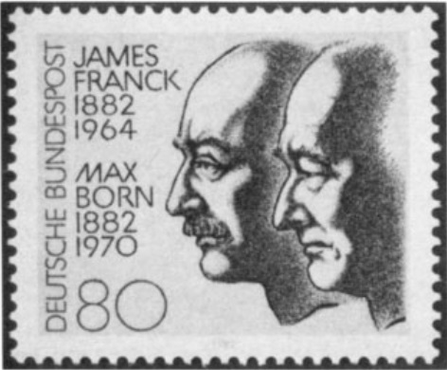
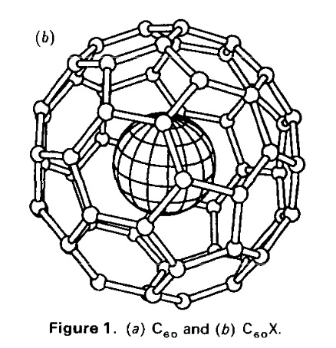
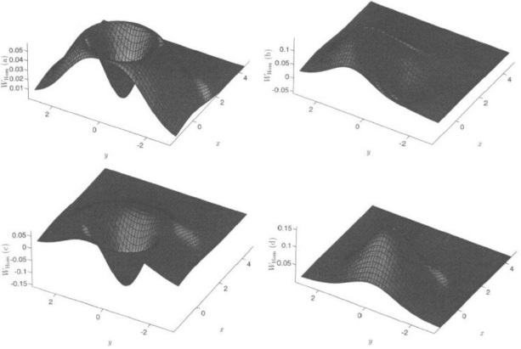
Institute of Physics (IOP) Journal Archive
(1874-1998)
Over 110, 000 articles from more than 50 journals published by the Institute of Physics between 1874 and 1998, providing a key research resource for the physical sciences.
Spanning over 800 volume years and covering the core subject areas of: applied physics computer science, condensed matter and materials science, general physics, high energy and nuclear physics, mathematics, applied mathematics and mathematical physics, measurement science and sensors, medical and biological sciences, optical, atomic and molecular physics, physics education and plasma physics.

Slide 7
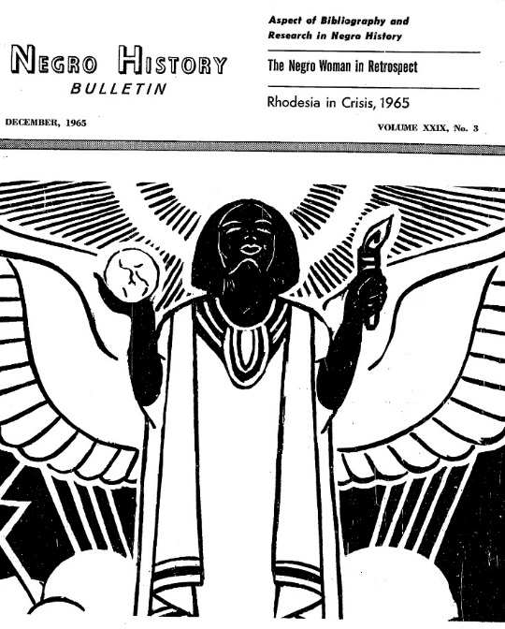
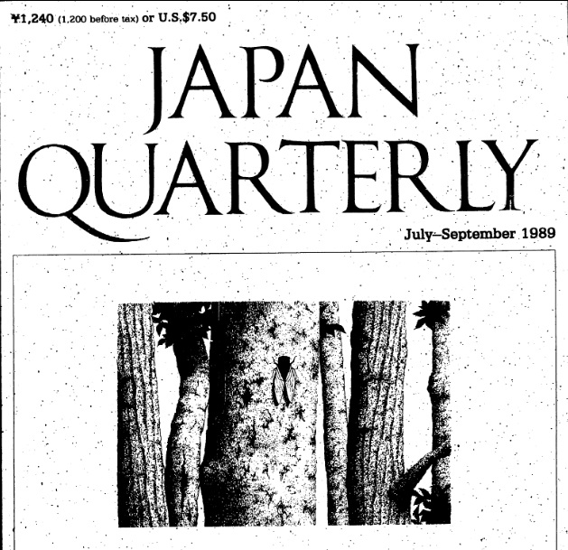
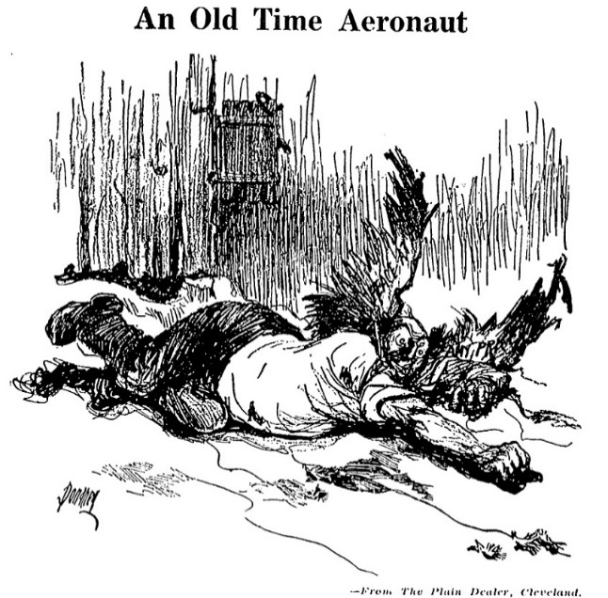
Periodicals Archive Online - Jisc Collections Selection
(1891 – 2000)
Over 288,000 articles from a subset of 80 journal backfiles published between 1891 and 2000 from the Periodicals Archive Online collection.
Covering a range of subject areas including Arts, Business, History, Linguistics, Literature, Philosophy, Politics, Psychology and the Social Sciences.

Slide 8
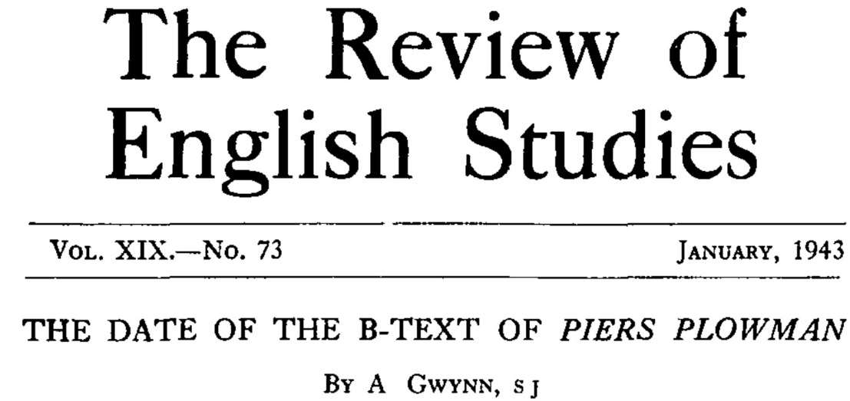
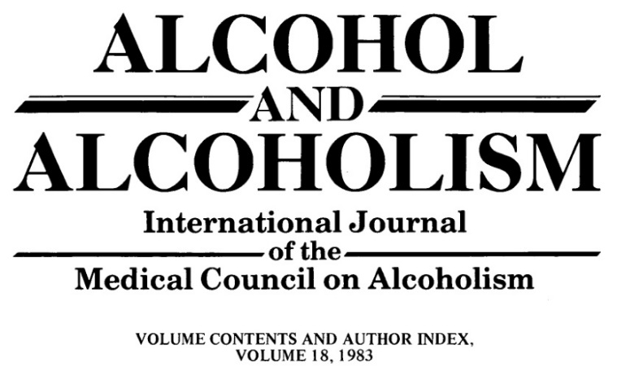
Oxford Journals Archive and Archive Upgrade (Oxford University Press)
(1849 - 1995)
Oxford Journals Archive contains over 3 million articles from over 140 prestigious journals published by Oxford University Press between 1849 and 1995.
The Oxford Journals Archive Upgrade contains an additional 32 OUP journals that have been digitised since the original archive was purchased by Jisc Collections in 2006.
There are five subject based archives included: Humanities, Law, Medicine, Science and Social Science

Slide 9
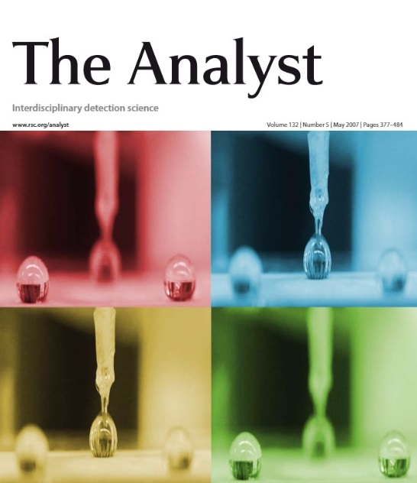
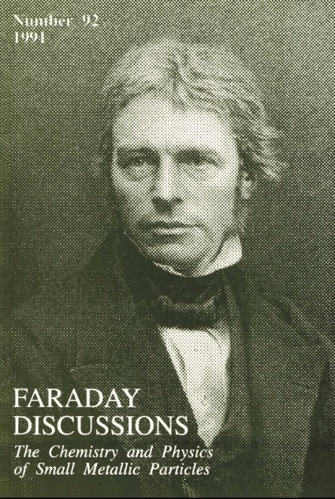
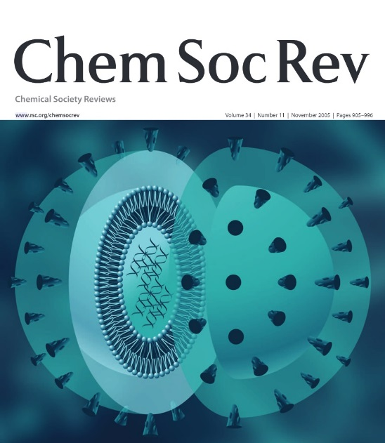
Royal Society of Chemistry (RSC) Journals Archive
(1841-2004)
Over 238,000 peer reviewed articles of ground-breaking chemical science published by the Royal Society of Chemistry, and its forerunner societies, between 1841 and 2004.
Subjects covered include biology, biophysics, energy and environment, engineering, materials, medicine, physics and chemical sciences.

Slide 10
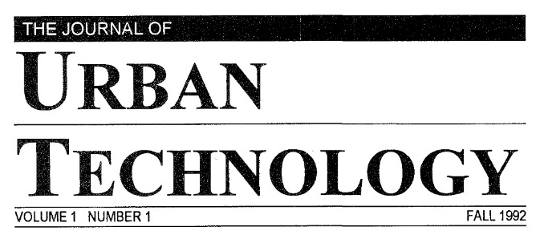
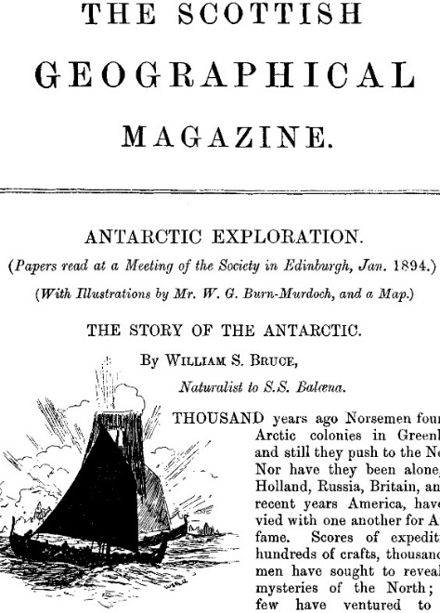
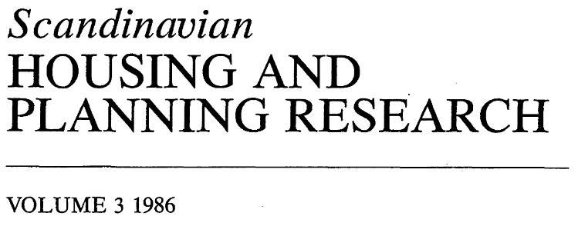
Taylor & Francis Geography, Planning, Urban and Environment Online Archive
(1885 to 1996)
Over 20,000 articles from the backfiles of 28 journals published under the Routledge imprint until 1996.
Providing a wealth of resources in environmental and architecture studies, geography, planning studies and urban studies, it includes a number of journals affiliated with organisations such as the ‘Journal of Architecture’, published jointly with the Royal Institute of British Architects.

Slide 11
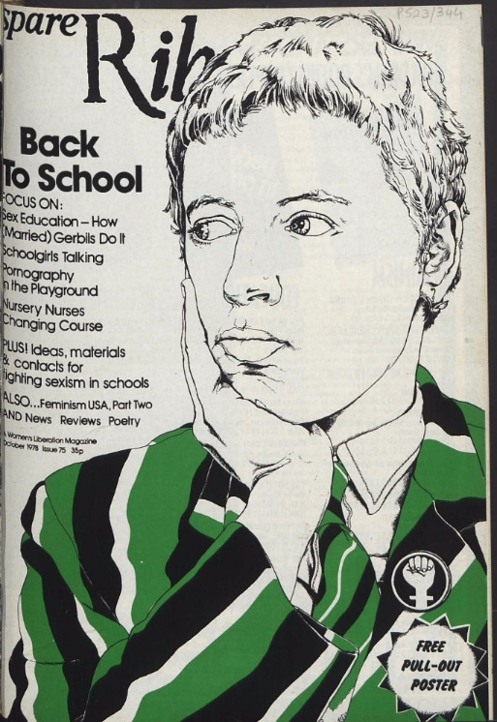
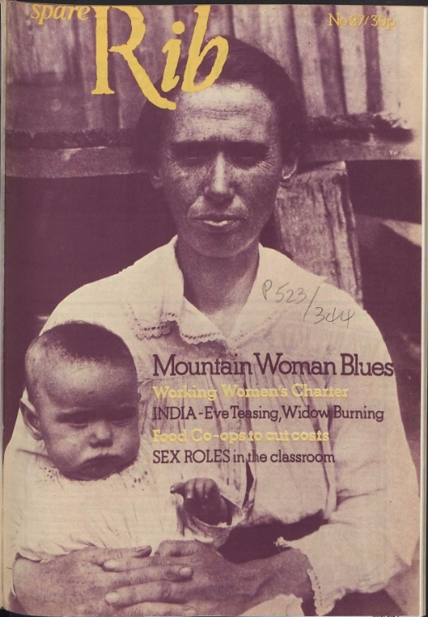
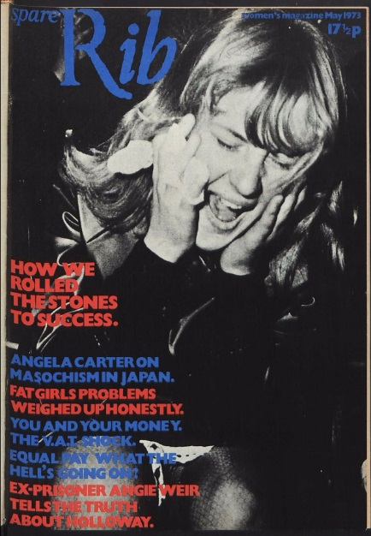
Spare Rib
(1972-1992)
Spare Rib was the largest feminist circulating magazine of the Women's Liberation Movement (WLM) in Britain of the 1970s and 80s
The Spare Rib digitisation project makes available the entire run of fully searchable Spare Rib magazines.

Slide 12
Key features
Easy web access to four million articles via a simple user interface and article viewer.
Search by Author, Article Title, Journal Title, ISSN or across the full text.
View online or download articles as PDFs for offline use.
Provides online access to journal articles 24/7.
Enables search of eight publishers’ archives in one place.

Slide 13
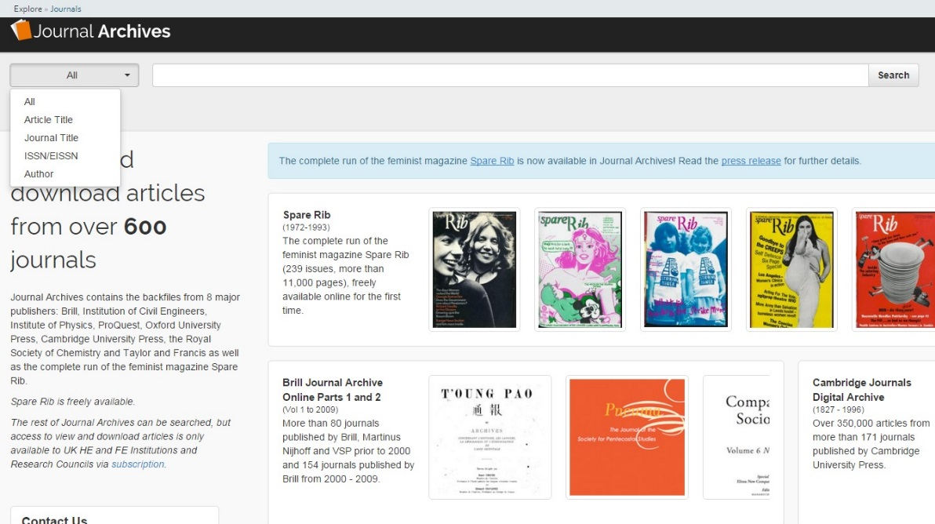
Search
Choose which fields to search on here
Enter your search terms here
Click this link to open the Spare Rib page

Slide 14
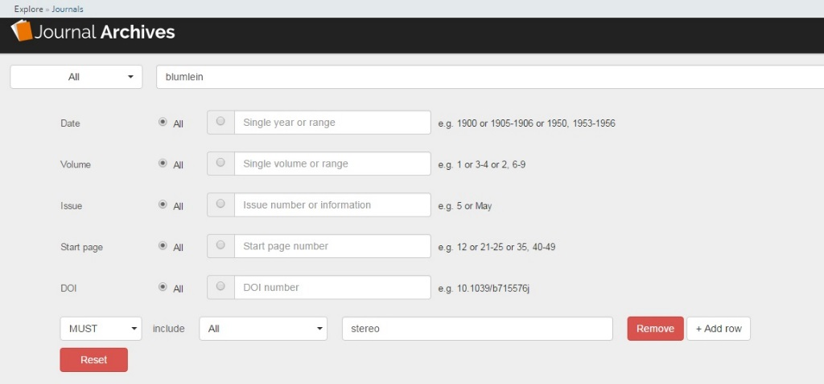
Advanced search
Additional search fields for
Date, Volume, Issue, Start Page
and DOI
Add rows with search terms that MUST, MUST NOT or SHOULD be included
Use the Advanced options to search by Date, Volume, Issue, Start Page or DOI. Add rows to combine filters with Boolean-style conditional logic.

Slide 15
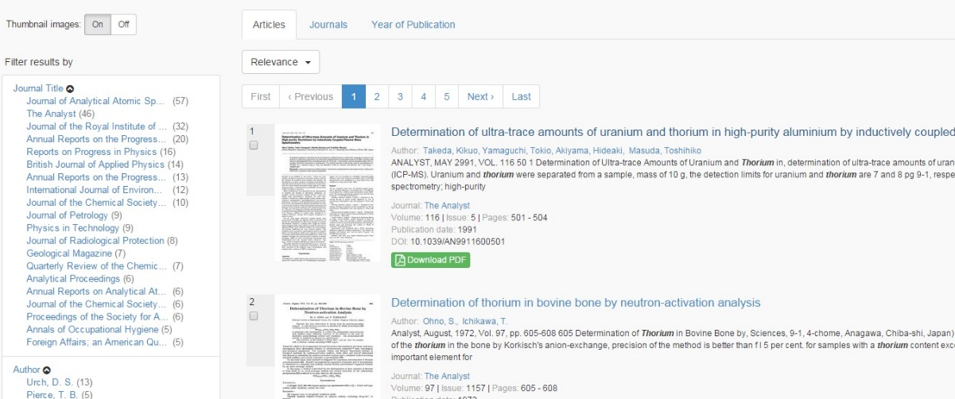
Filter Results
Click these tabs to browse search results by Article, Journal Title or Year of Publication
Click drop-down to order results by Relevance, Year or Journal Title
Filter by Journal Title, Author or Year of
Publication
Users can also toggle thumbnail images on and off, browse their results by page, and
choose between a list or a tile view of their results

Slide 16
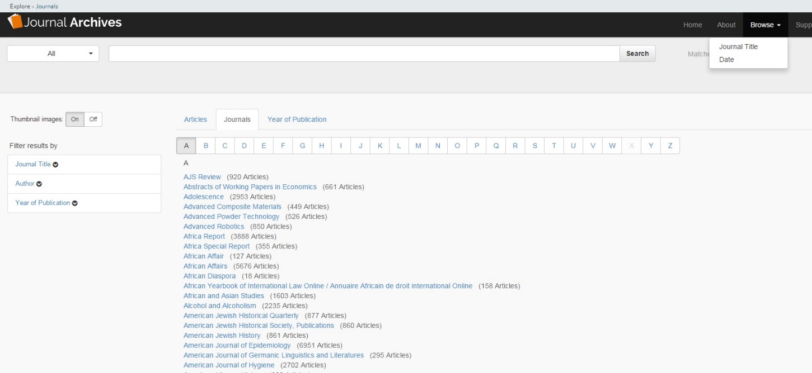
Browse whole catalogue
Click the tabs to browse by Article,
Journal Title or Date
Click the Browse drop-down arrow, then select Journal Title or Date to start browsing
Click here to browse Journal Titles alphabetically.
Journal Archives allows users to browse (as opposed to search) the entire catalogue, by Article Title, Journal Title or Date should they wish.

Slide 17
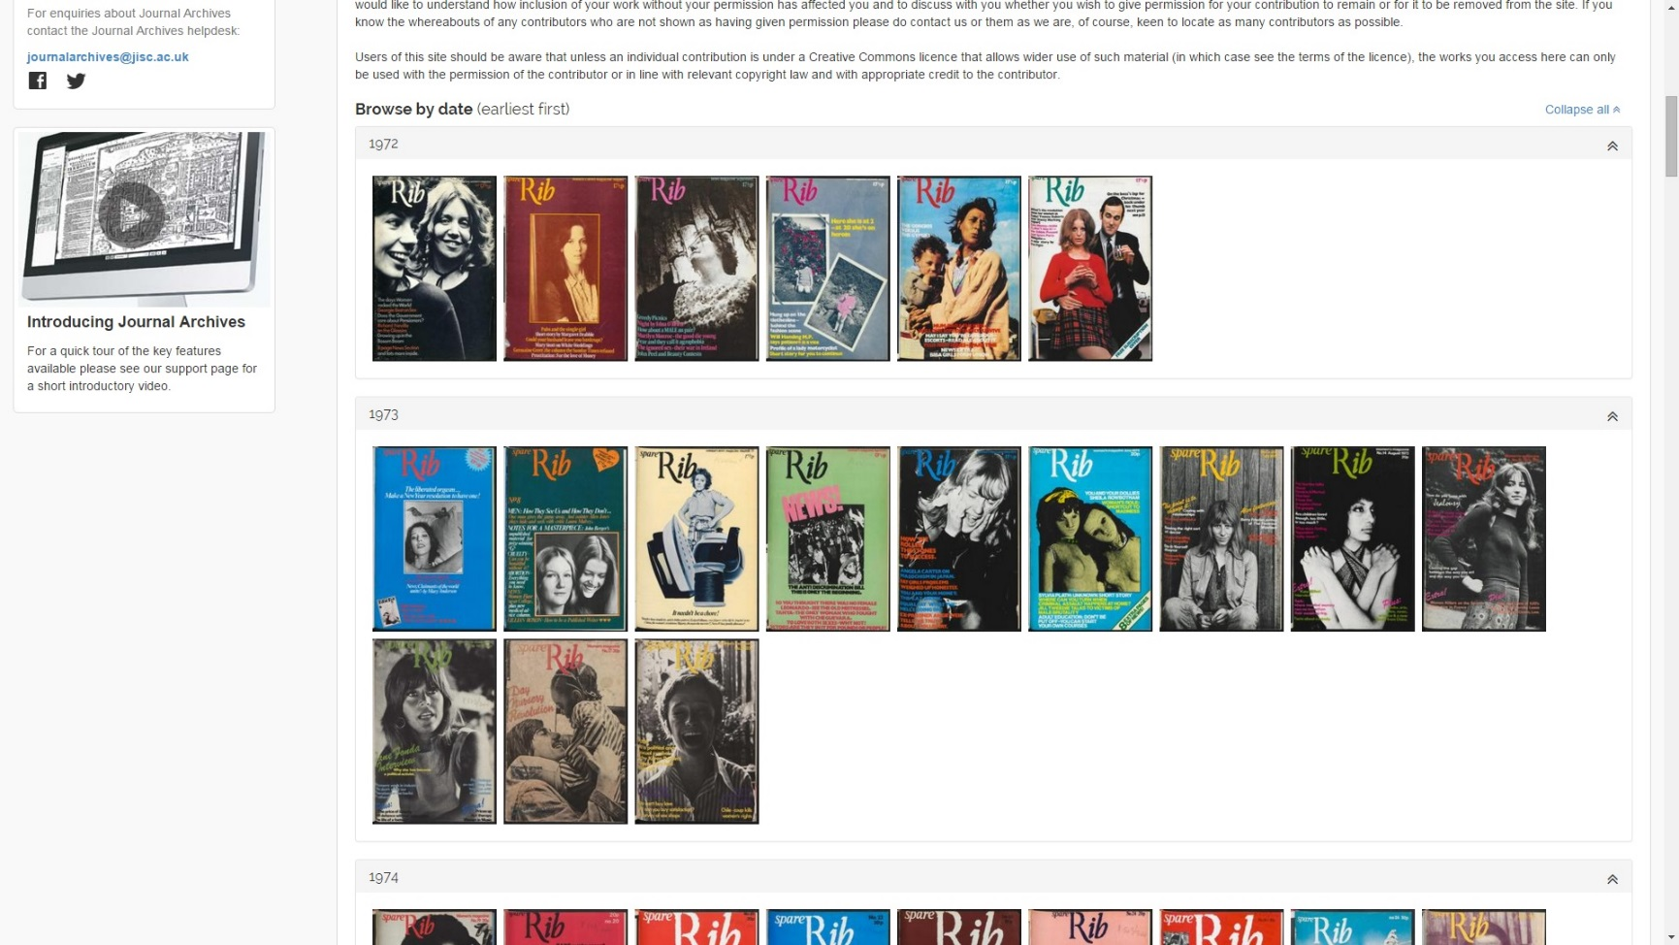
Spare Rib
The Spare Rib page allows users to search for
articles only from the Spare Rib
archive, and to browse complete issues of
the journal.

Slide 18
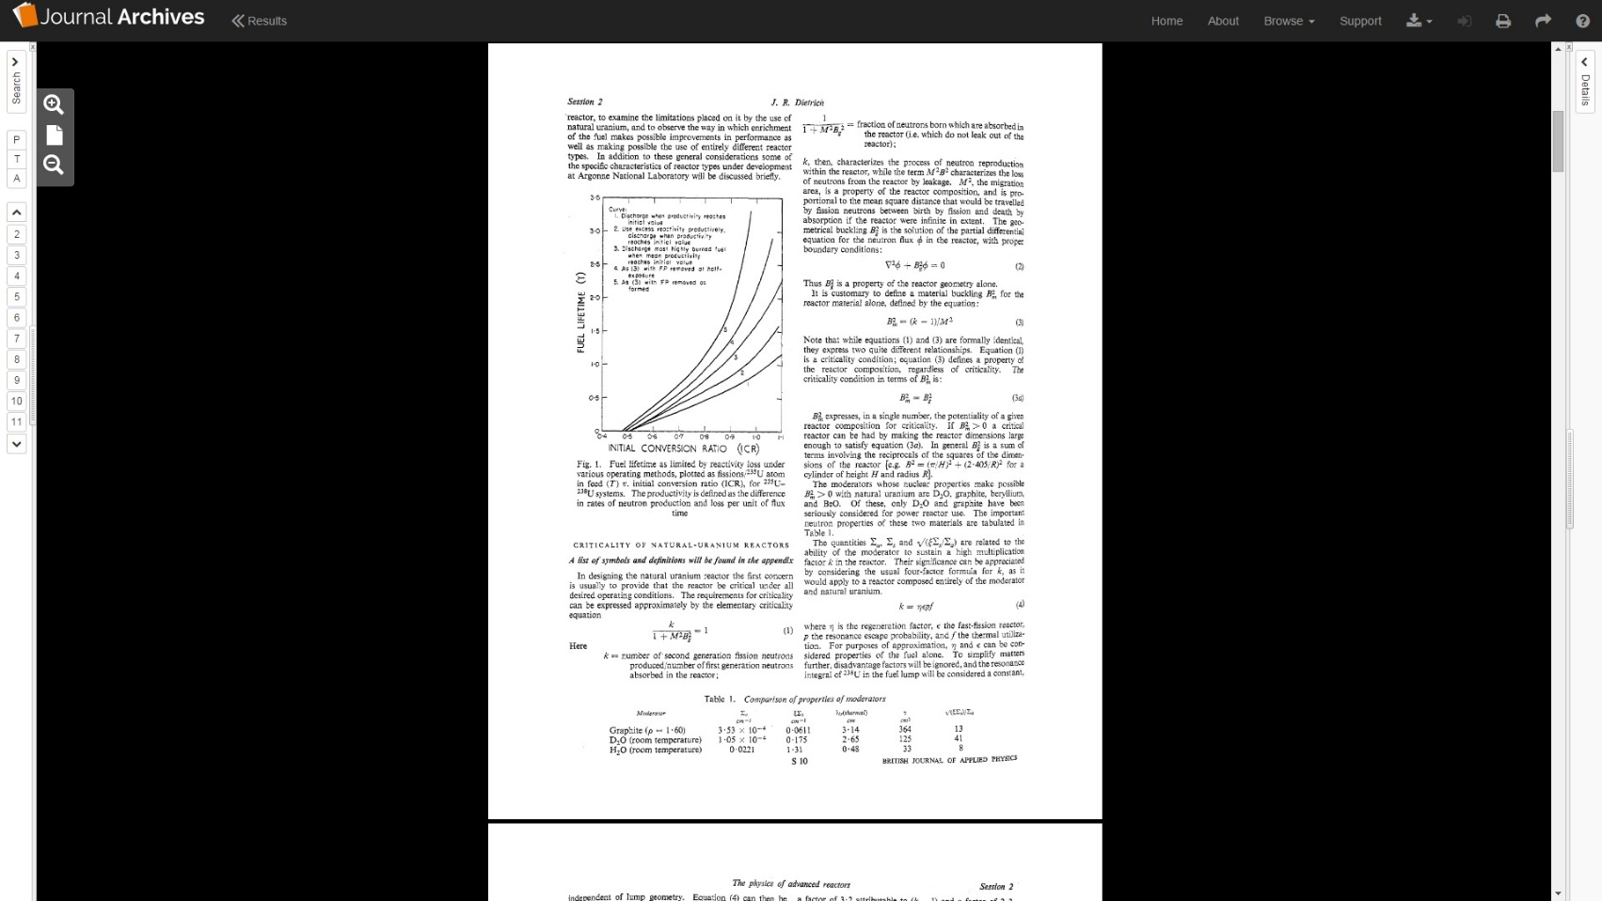
Viewer
Click here to return to your search results
Click here to
open the Search panel
Links to download the
article as a PDF, access
a permanent URL
or print are found in the
toolbar
Zoom in or out,
or reset the view
to the default size here
Click here to open the
Details panel
Drag the handle
to resize the
Search panel
Drag the handle to resize the Details panel

Slide 19
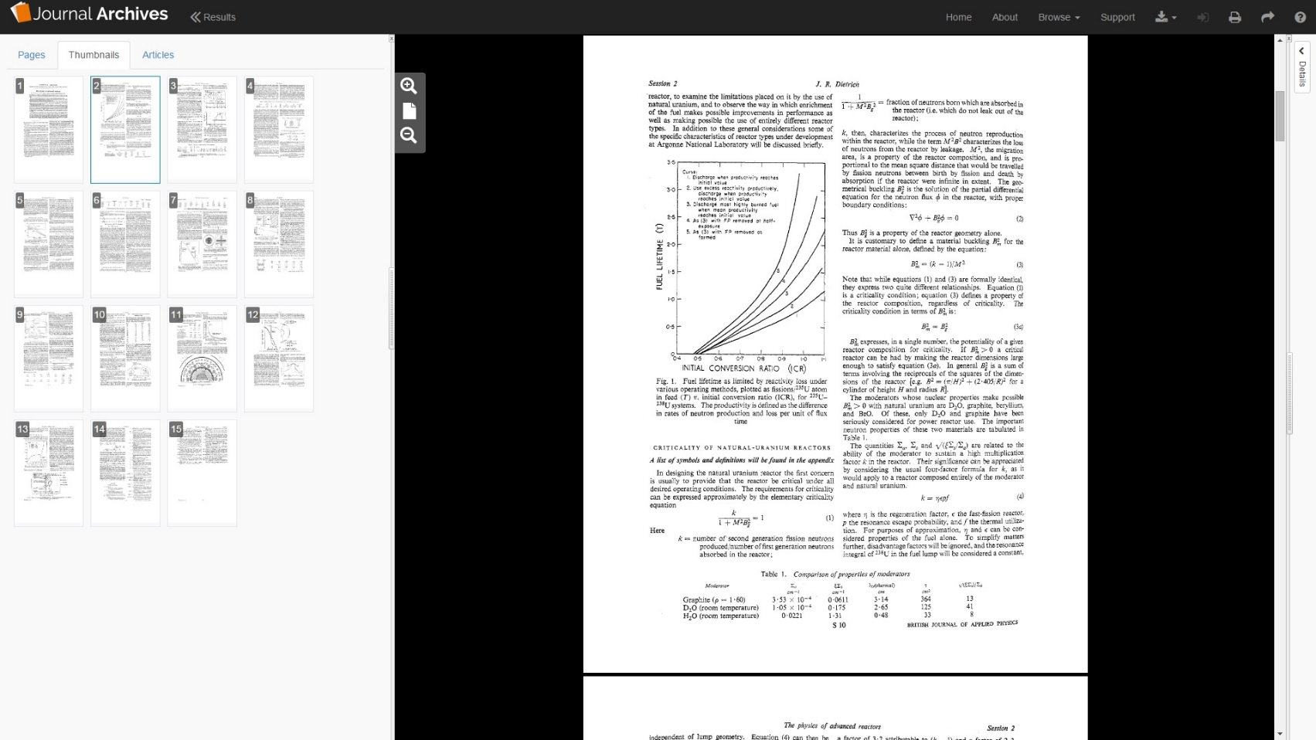
Viewer (Search panel)
The Pages Tab allow you to see a list of search matches in the article and jump directly to them. The Articles Tab display links to related articles
Thumbnail images for the pages. Click one to jump to that page in the main viewer

Slide 20
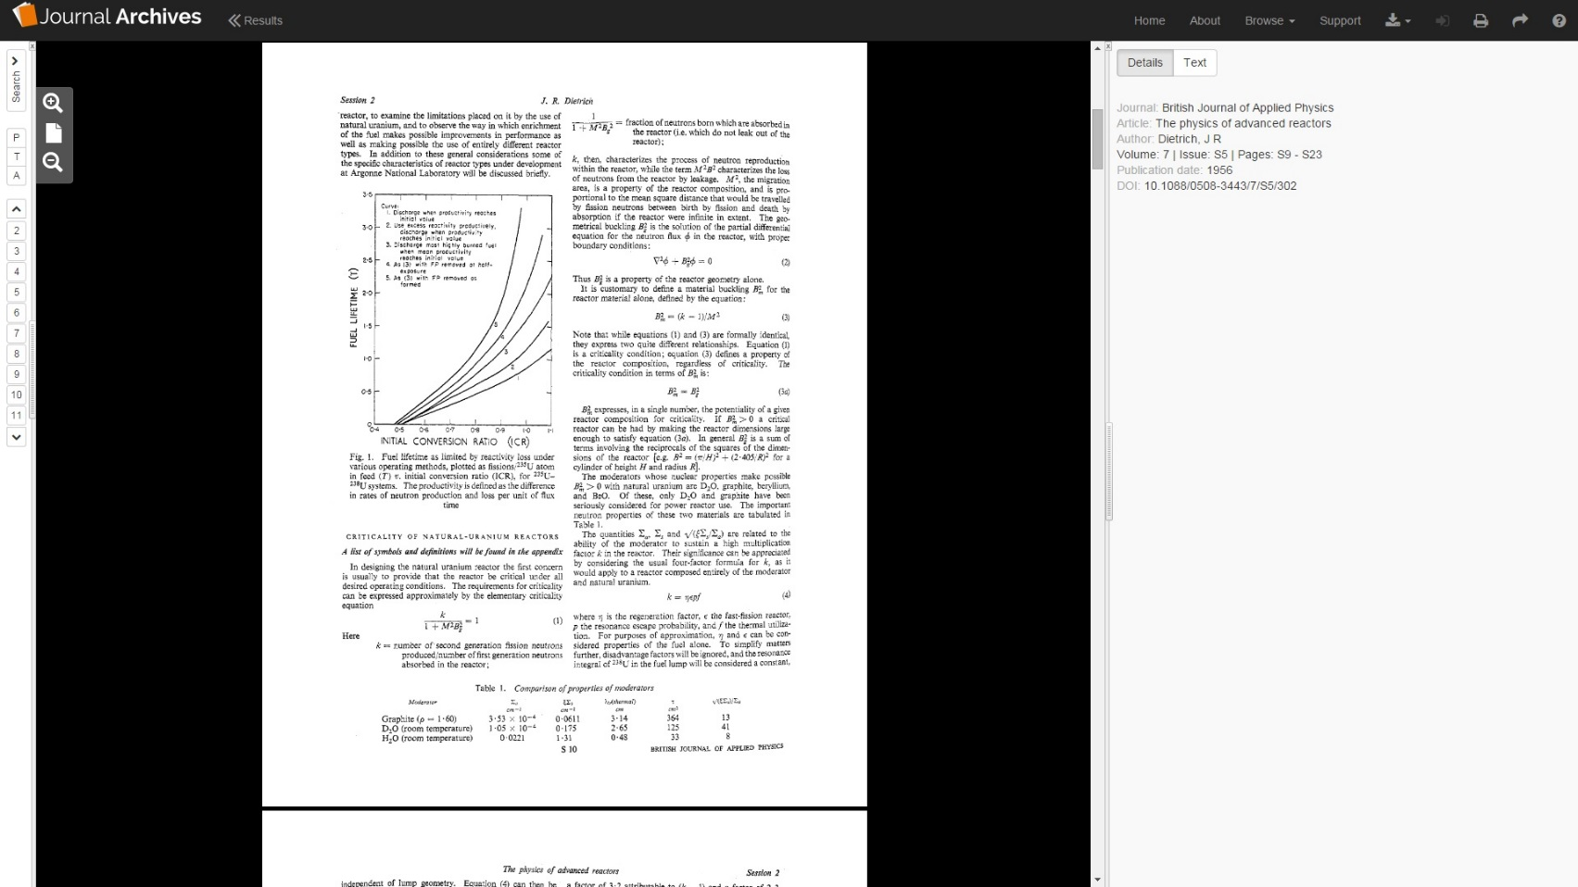
Viewer (Details panel)
The Details Tab shows the bibliographic data for the article
The Text tab shows the full
Text of the article

Slide 21
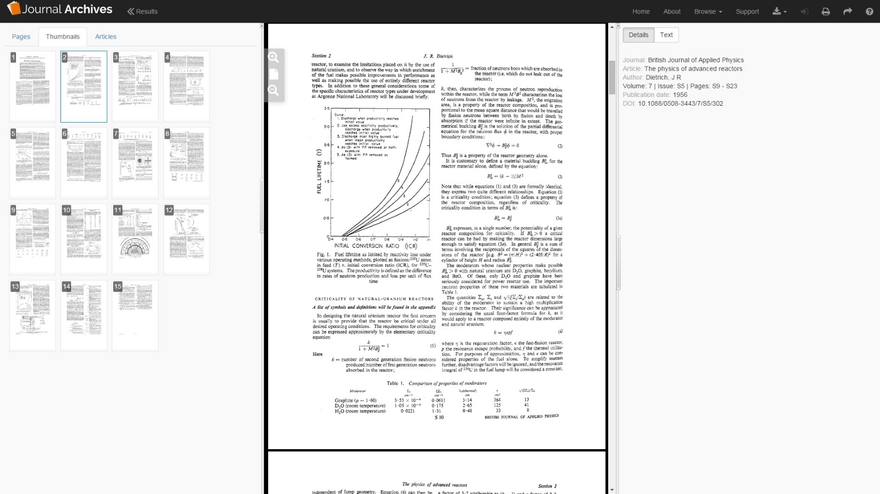
Viewer (all panels)
Users can open all
three panels
simultaneously
if desired

Slide 22
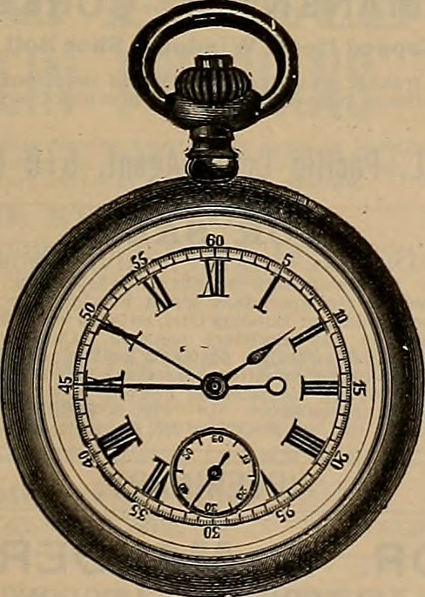
Benefits for researchers
It’s convenient – access Journal Archives online anytime, anywhere to make use of a huge range of journals.
Cross-search the full text of all EIGHT collections simultaneously – this is unique to the Journal Archives service.
Time saving – reducing need to travel to holding libraries to view texts or order via Inter-Library Loan.
Cost savings – no need to pay by-the-article for Inter-Library Loans.

Slide 23
Further information
Website: http://journalarchives.jisc.ac.uk
Support materials: http://journalarchives.jisc.ac.uk/support
Development roadmap: http://journalarchives.jisc.ac.uk/developmentroadmap
Helpdesk: journalarchives@jisc.ac.uk

